Slide 1

CPRG 307 Slides are part of the Instructor Resources for the course required textbook and are provided with permission from the publisher:
Oracle 11g: PL/SQL Programming
Joan Casteel
978-1-133-94736-3
Course Technology (Cengage Learning)
Oracle11g:
PL/SQL Programming
Chapter 4
Cursors and
Exception Handling

Slide 2
Exception Handlers
Used to capture error conditions and handle the processing to allow the application to continue
Placed in the EXCEPTION section of a PL/SQL block
Two types of errors
    Oracle errors (Predefined and Non-Predefined)
    User-defined errors
      RAISE
      RAISE_APPLICATION_ERROR
Oracle11g: PL/SQL Programming

Slide 3
Predefined Oracle Errors
Exception Name
Description
NO_DATA_FOUND
A SELECT statement in a PL/SQL block retrieves no rows or a nonexistent row of an index-by table is referenced
TOO_MANY_ROWS
A SELECT statement in a PL/SQL block retrieves more than one row
CASE_NOT_FOUND
No WHEN clause in the CASE statement is processed
ZERO_DIVIDE
Attempted division by zero
DUP_VAL_ON_INDEX
Attempted violation of a unique or primary key column constraint
Oracle11g: PL/SQL Programming

Slide 4
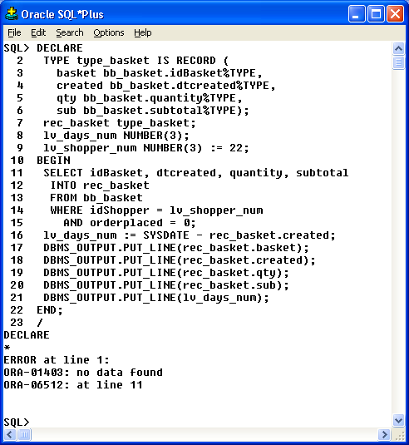
Predefined Error Example
Oracle10g Developer: PL/SQL Programming

Slide 5
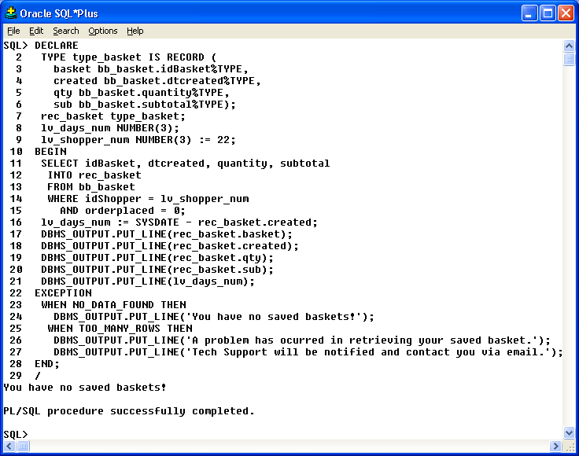
Add Exception Handler
Oracle10g Developer: PL/SQL Programming

Slide 6
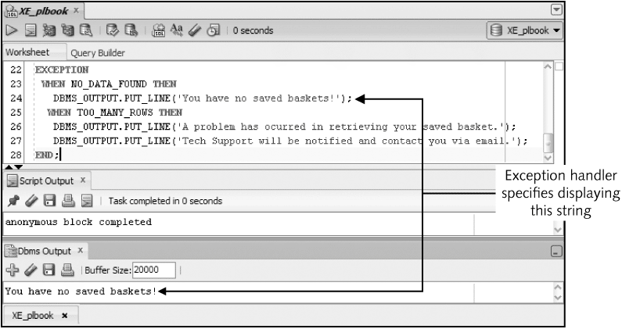
Predefined Error Example
Oracle11g: PL/SQL Programming

Slide 7
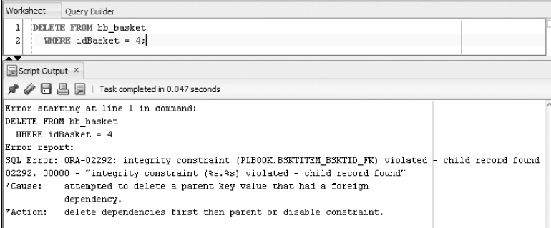
Undefined Error
Identify possible errors for statements in a block
Oracle11g: PL/SQL Programming

Slide 8
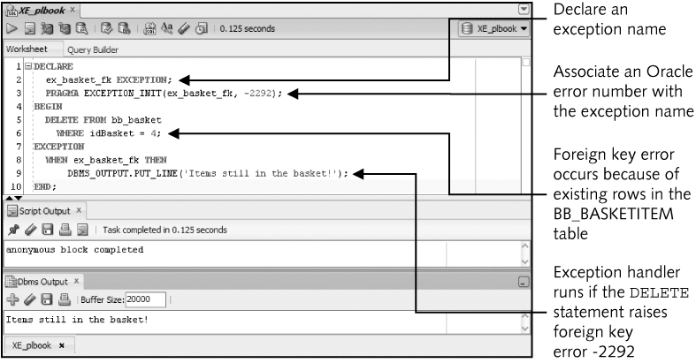
Handler Added
Oracle11g: PL/SQL Programming

Slide 9
User-Defined Exception
No system error is raised
Raise errors to enforce business rules
Once error is raised, the remaining statements in the executable sections are not executed
Processing moves to the exception area of the block
Oracle11g: PL/SQL Programming

Slide 10
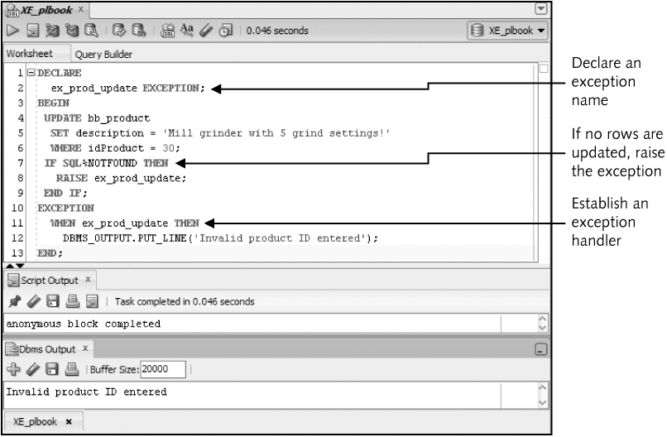
User-Defined Exception Example
Oracle11g: PL/SQL Programming

Slide 11
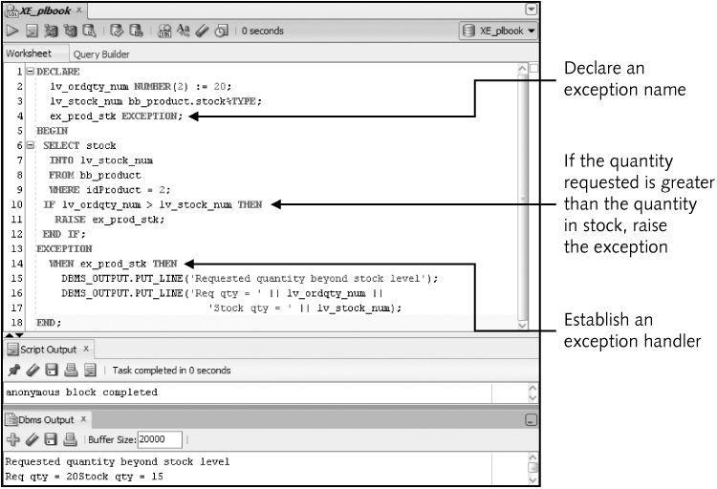
User-Defined Exception Example
Oracle11g: PL/SQL Programming

Slide 12
Additional Exception Concepts
WHEN OTHERS – traps all errors not specifically addressed by an exception handler and used for handling unanticipated errors (like an “else”)
  Must be the last exception listed in the exception block.
  All code should have this exception condition
SQLERRM – function used to identify the error code and message
  Can be used in WHEN OTHERS to identify unanticipated errors
Oracle11g: PL/SQL Programming

Slide 13
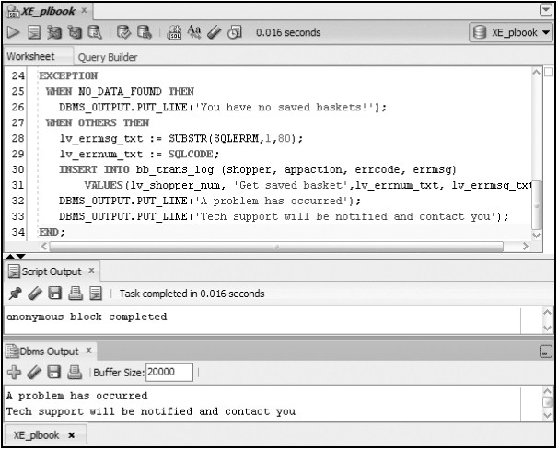
Example
Oracle11g: PL/SQL Programming

Slide 14
SQLERRM
Other small testing routine, our errors will generally be logged to an error table.
EXCEPTION
WHEN OTHERS THEN
ROLLBACK;
v_msg := SUBSTR(SQLERRM, 1, 100);
INSERT INTO error_log
(empno, msg)
VALUES
(v_empno, v_msg);
COMMIT;
CPRG 307

Slide 15
RAISE_APPLICATION_ERROR
Allows developers to associate their own error number and message to an error
There is an error in the textbook that states this can only be used with stored programs (will be discussed in Module 6); this is incorrect. RAISE_APPLICATION_ERROR can be used in anonymous blocks as well.
RAISE should be limited only to anonymous blocks.
CPRG 307

Slide 16
RAISE_APPLICATION_ERROR
You can write the error message directly to the screen with DBMS_OUTPUT.PUT_LINE or to an error table (a table you create with specific information in it to identify the row in error).
You should be aware of how to handle both ways.
The error number is a range of -20000 to -20999 (always a negative number).
RAISE_APPLICATION_ERROR(<error code>, <text message>);
CPRG 307

Slide 17
RAISE_APPLICATION_ERROR
Example (output to screen):
BEGIN
DELETE student
WHERE student_id = '000939432';
IF SQL%NOTFOUND THEN
RAISE_APPLICATION_ERROR(-20005, 'Invalid student id');
END IF;
EXCEPTION
WHEN OTHERS THEN
DBMS_OUTPUT.PUT_LINE('000939432' || ' – ' || SQLERRM);
END;
CPRG 307

Slide 18
RAISE_APPLICATION_ERROR
Assume the following code has been executed to create the error log table:
CREATE TABLE student_error_log
(student_id VARCHAR2(9),
error_msg VARCHAR2(50));
CPRG 307

Slide 19
RAISE_APPLICATION_ERROR
Example (output to error log table):
DECLARE
lv_error_msg VARCHAR2(50);
BEGIN
DELETE student
WHERE student_id = '000939432';
IF SQL%NOTFOUND THEN
RAISE_APPLICATION_ERROR(-20005, 'Invalid student id');
END IF;
COMMIT;
EXCEPTION
WHEN OTHERS THEN
lv_error_msg := SUBSTR(SQLERRM, 1, 50);
INSERT INTO student_error_log
VALUES
('000939432', lv_error_msg);
COMMIT;
END;
CPRG 307

Slide 20
Exception Propagation
Exception handling in nested blocks
Exception raised in a block will first look for handler in the exception section of that block, if no handler found, execution will move to the exception section of the enclosing block
Error in DECLARE section propagates directly to exception section of the enclosing block
Error in exception handler propagates to exception section of the enclosing block
Oracle11g: PL/SQL Programming

Slide 21
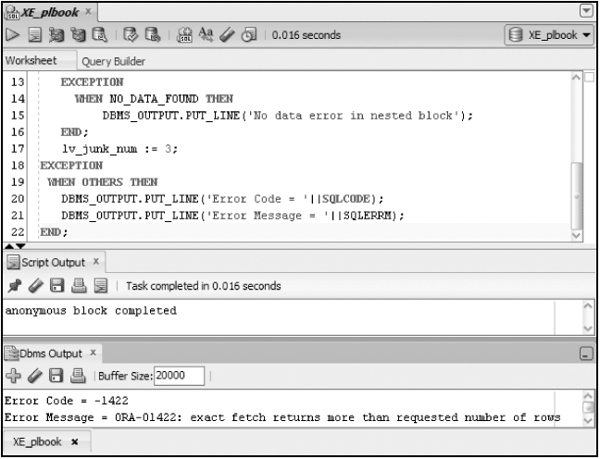
Exception Propagation
Oracle11g: PL/SQL Programming

Slide 22
Exception Propagation
The error log should be written to by the main exception block only; all other exception blocks flow to this one.
  Usually the looping exception will be the main exception block.
CPRG 307

Slide 23
Nesting of Blocks – Exception Propagation
DECLARE
CURSOR c_new_expertise IS
SELECT *
FROM new_expertise;
lv_error_msg VARCHAR2(50);
lv_course course.course_code%TYPE;
lv_count NUMBER;
BEGIN
FOR r_new_expertise IN c_new_expertise LOOP
BEGIN
BEGIN
SELECT course_code
INTO lv_course
FROM course
WHERE course_code = r_new_expertise.course_code;
EXCEPTION
WHEN no_data_found THEN
RAISE_APPLICATION_ERROR(-20001, 'Invalid course code');
END;
CPRG 307

Slide 24
Nesting of Blocks – Exception Propagation (Cont.)
SELECT COUNT(employee_id)
INTO lv_count
FROM faculty
WHERE employee_id = r_new_expertise.employee_id;
IF lv_count < 1 THEN
RAISE_APPLICATION_ERROR(-20001, 'Invalid employee');
END IF;
INSERT INTO EXPERTISE
(employee_id, course_code, expertise_level)
VALUES
(r_new_expertise.employee_id, r_new_expertise.course_code, r_new_expertise.expertise_level);
COMMIT;
CPRG 307

Slide 25
Nesting of Blocks – Exception Propagation (Cont.)
EXCEPTION
WHEN OTHERS THEN
ROLLBACK;
lv_error_msg := SUBSTR(SQLERRM, 1, 50);
INSERT INTO error_log
(employee_id, course_code, msg)
VALUES
(r_new_expertise.employee_id, r_new_expertise.course_code, lv_error_msg);
COMMIT;
END;
END LOOP;
END;
/
CPRG 307

